Slide 1

Estatecore
The Core of Smart Real Estate
Ali Hasnain-BSSE23066
Umar Ahmad-BSSE23032

Slide 2
Introduction
Real-estate platforms require scalable and secure online systems
Traditional systems face performance and availability issues
Cloud computing enables efficient, reliable, and scalable solutions
EstateCore is designed using modern cloud-based technologies

Slide 3
Problem statement
Existing real-estate systems use monolithic architectures
High customer traffic affects system performance
Downtime occurs during updates and maintenance
Limited scalability and weak fault isolation
Security and data management challenges

Slide 4
Aim & Objectives
Aim:
To design and deploy a scalable cloud-based real-estate platform
Objectives:
Separate customer and agent operations
Ensure high availability and reliability
Improve system performance and security
Deploy backend using cloud infrastructure

Slide 5
Proposed Solution
Cloud-based real-estate management system
Backend deployed on AWS EC2
MongoDB Atlas used for database management
Amazon S3 used for storing frontend and images
PM2 used for backend process management

Slide 6
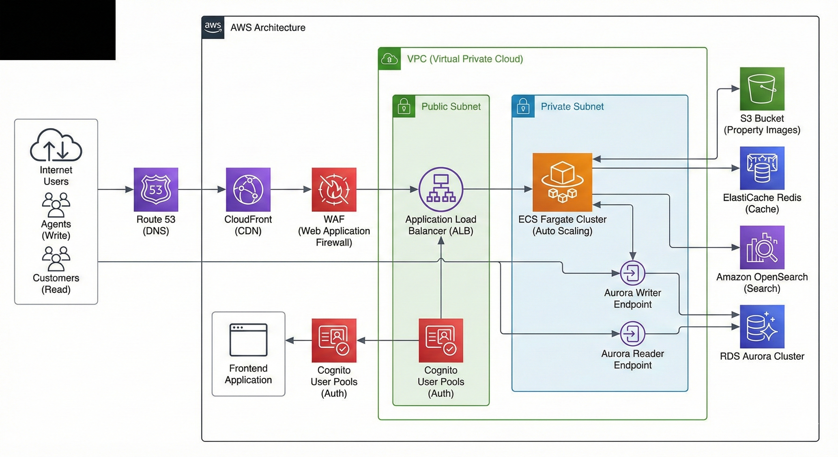
Architecture diagram

Slide 7
Key Workflow
User accesses frontend hosted on Amazon S3
Requests are sent to backend API on EC2
Backend processes requests using Node.js
Data is stored and retrieved from MongoDB Atlas
Property images are stored in Amazon S3

Slide 8
Implementation Details
EC2 instance launched for backend hosting
Secure server access via SSH
Backend code deployed using SCP
PM2 used to manage backend services
Frontend deployed as static files on S3

Slide 9
Conclusion
EstateCore provides a scalable cloud-based solution
System improves performance and reliability
Cloud services simplify deployment and management
Project demonstrates practical use of cloud computing
Suitable for real-world real-estate platforms

Slide 10
Thank you

